Slide 1


III. Generation of the
B and T cell repertoires
by Bruno Lemaitre,
Ecole Polytechnique Fédérale de Lausanne
Web: http://ghi.epfl.ch

Slide 2
Properties of adaptive immune responses
Feature | Functional significance
Specificity | Distinct antigens elicit specific responses
Diversity | Immune responses to a large variety of antigens
Memory | Enhanced response when repeatedly exposed to the same antigen
Clonal Expansion | Antigen-specific lymphocytes increase in number to keep pace with microbes
Non-reactivity to self | No injury to host while responding to foreign antigens
The two features that best distinguish adaptive and innate immunity are specificity and memory.

Slide 3

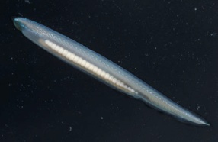

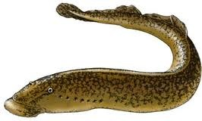
Evolutionary origin of the adapative immune system
Pattern recognition receptors
TLR>200
NLR>200
Echinoderms
Cephalochordate
System VLR
Chordates
Urochordate
Lamprey (jawless)
Vertebrate
Adaptative
immunity
Gnathostomes

Slide 4
Questions
How do the antigen receptors of lymphocytes recognize extremely diverse antigens?
How is the vast diversity of receptor structures generated in lymphocytes?
The diversity of antigen recognition implies the existence of many structurally different antigen receptor proteins, more than can reasonably be encoded in the inherited genome (germline).

Slide 5
Outline
III-1 Structure of Lymphocyte Antigen Receptors
III-2 Development of Immune Repertoires
III-3 Organs and Tissues of the Immune system

Slide 6
III-1
Structure of Lymphocyte Antigen Receptors
Antibodies and B cell receptors
  Purification
  Structure
  Features of antigen recognition
The T Cell receptor
Summary

Slide 7
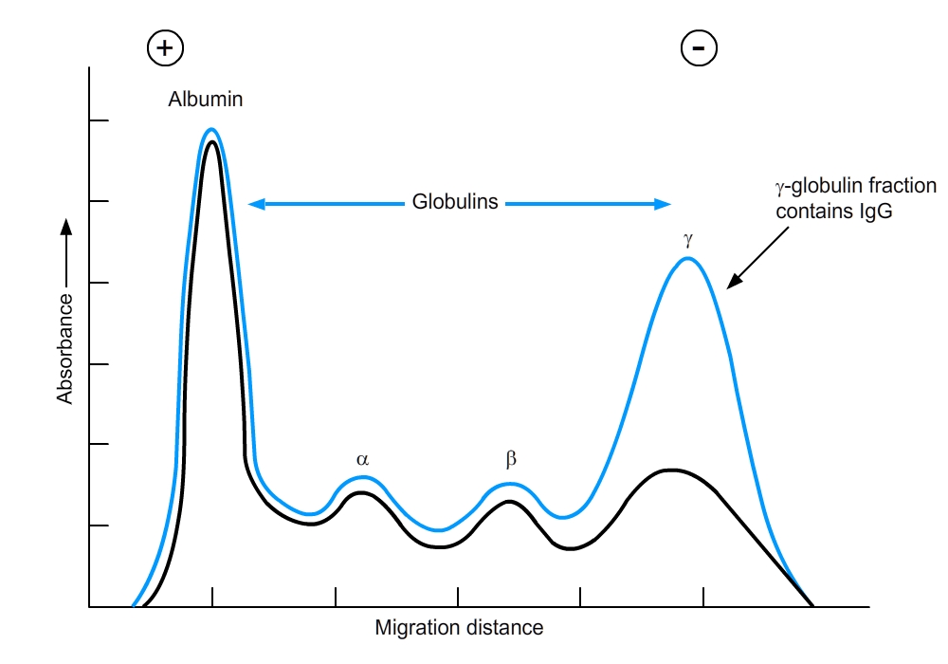
Historical experiment by Tiselius and Kabat (1939)
Immunization of rabbits with ovalbumin, serum electrophoresis of immune serum or of ovalbumin-absorbed immune serum

Slide 8
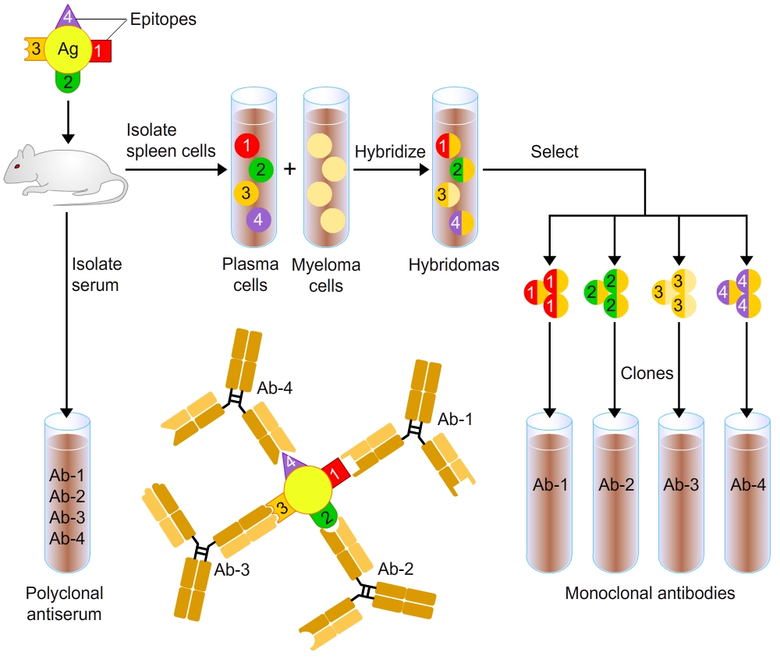
Monoclonal antibodies
(Koehler and Milstein, Nobel Prize 1978)

Slide 9
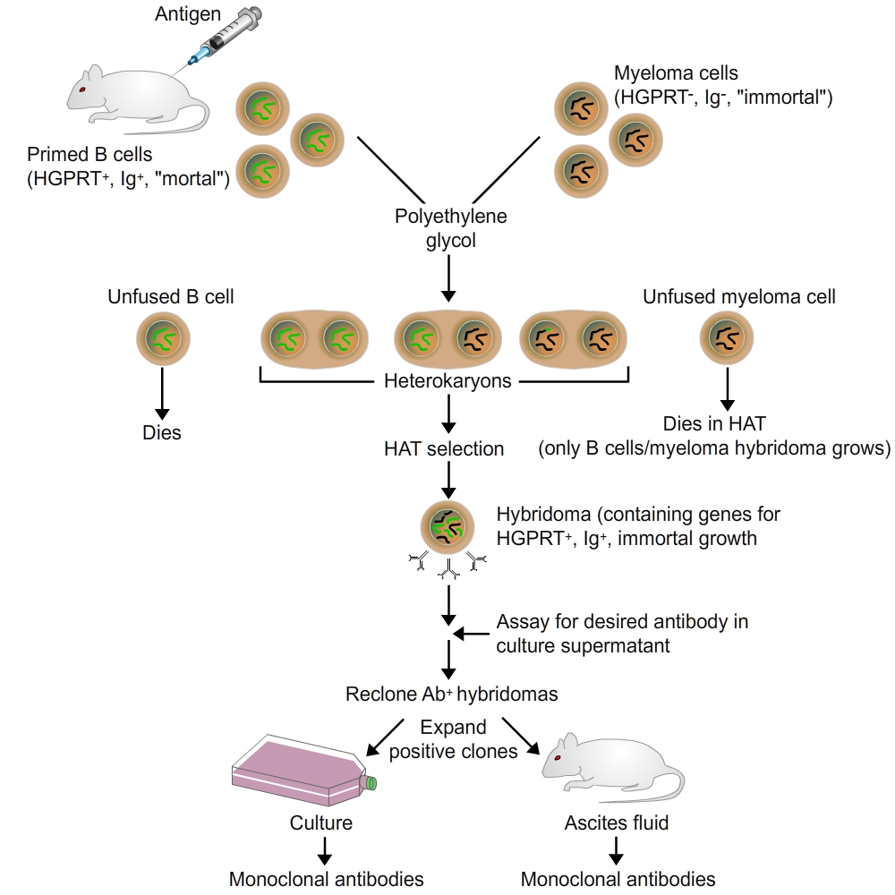
Monoclonal antibodies

Slide 10
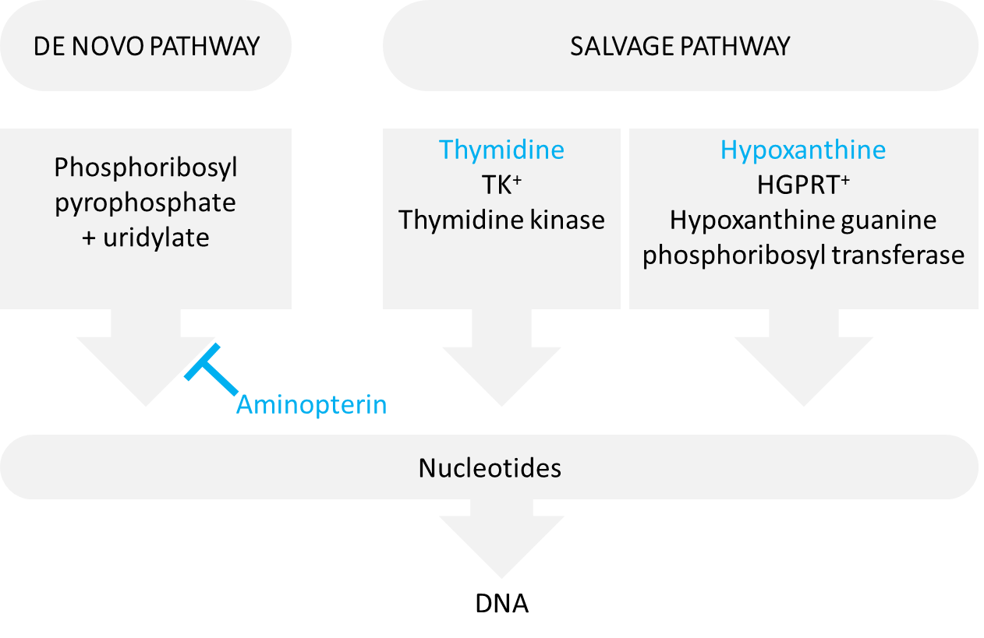
Monoclonal antibodies : Basis for in vitro selection
HAT medium: contains hypoxanthine, aminopterin and thymidine
→ only the salvage pathway for synthesis of purines and pyrimidines is functional

Slide 11
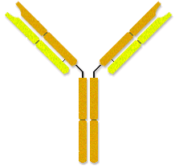
The B Cell receptor: Immunoglobulins (Igs)
Igs are composed of 2 heavy chains (50kDa) and 2 light chains (25kDa).
Membrane-bound and soluble Ig forms serve distinct functions.
Antigen receptor
Effector molecule
Antigen-binding sites
Heavy chain
Variable region
Light chain
Binding sites for:
complement component
receptors on phagocytes
Constant region
Membrane anchor
Membrane-bound Ig
Soluble Ig
Signal transduction

Slide 12
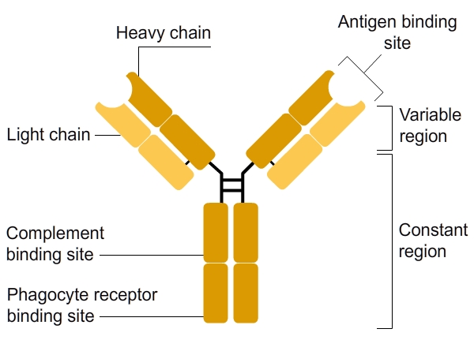
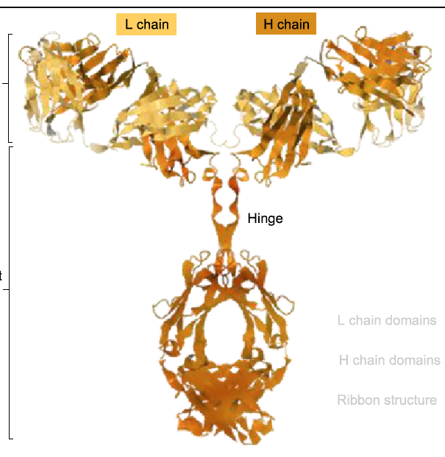
Structure of antibodies
Contain Variable (V) and Constant (C) domains
Each antibody has two identical antigen binding sites
The Fc domain determines the function
Fc domain
Ribbon model of an antibody

Slide 13
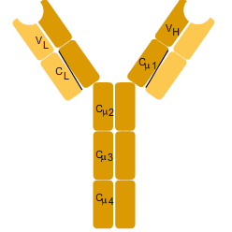
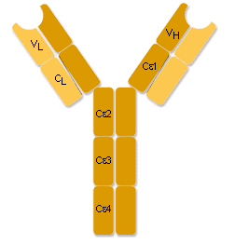
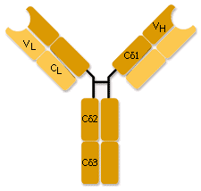
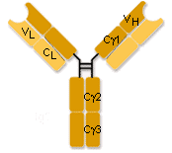
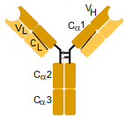
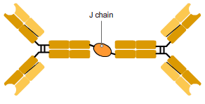
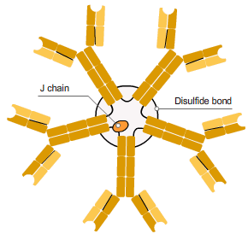
5 classes (isotypes) of Immunoglobulins
5 types of heavy chains: μ, δ, γ, ε and α
Heavy chain determines isotype: IgM, IgD, IgG, IgE or IgA
The different heavy chains differ in their constant region.
Antibodies combine one type of heavy chain with one type of light chain (κ and λ)
Membrane-bound Ig
IgD
IgM
IgG
IgE
IgA
J chain
J chain
Disulfide bond
Secreted Ig

Slide 14
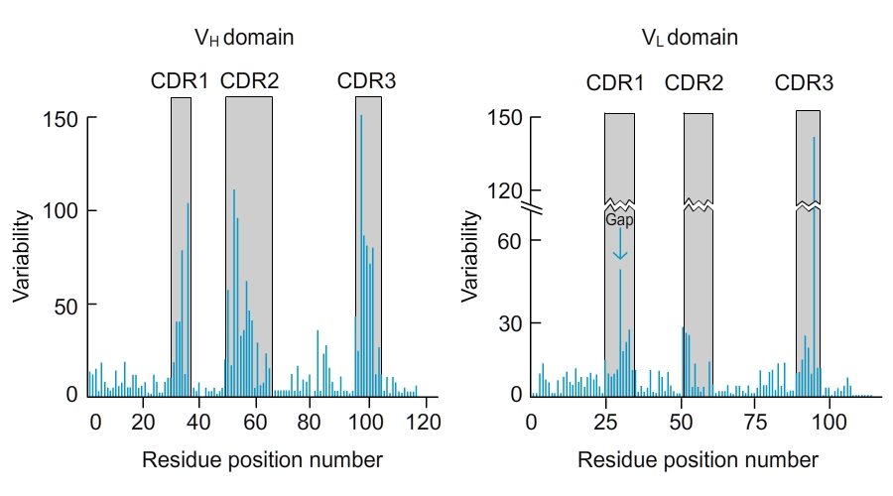
Diversity in V-region domain lies in
Complementary Domain Regions (CDRs)
Hypervariable regions = CDRs
Form antigen binding site in between framework regions
Variability =
# of different aa at given position
Frequency of most common aa at given position

Slide 15
Summary | Antibody classes
Two types of light chains, called κ and λ, that differ in their C regions but do not differ in function. Each B cell expresses either κ or λ, but not both.
Five types of heavy chains, called μ, δ, γ, ε, and α, that also differ in their C regions. Each type of light chain may complex with any type of heavy chain in an antibody molecule. Antibodies with different heavy chains belong to different isotypes, or classes, and are named according to their heavy chains (i.e., IgM, IgD, IgG, IgE, and IgA).
Each isotype has distinct physical and biological properties and effector functions:
  IgA: mucosal immunity
  IgD: naive B cell receptor
  IgE: mast cell activation, defense against helminths
  IgG: opsonization, complement activation, ADCC….
  IgM: naive B cell receptor, complement activation
The isotype switch: Naive B lymphocytes (mature B cells that have not yet encountered antigens) express membrane-bound IgM and IgD. After stimulation, the antigen-specific clone of B lymphocytes expands and differentiates into progeny that secretes antibodies of various classes. Some of the progeny of IgM- and IgD-expressing B cells may secrete IgM, and other progeny of the same B cells may produce antibodies of other heavy chain classes. Although heavy chain C regions may switch during humoral immune responses, each clone of B cells maintains its specificity, because the V regions do not change. The light chain class (i.e. κ or λ) also remains fixed throughout the life of each B cell clone.

Slide 16
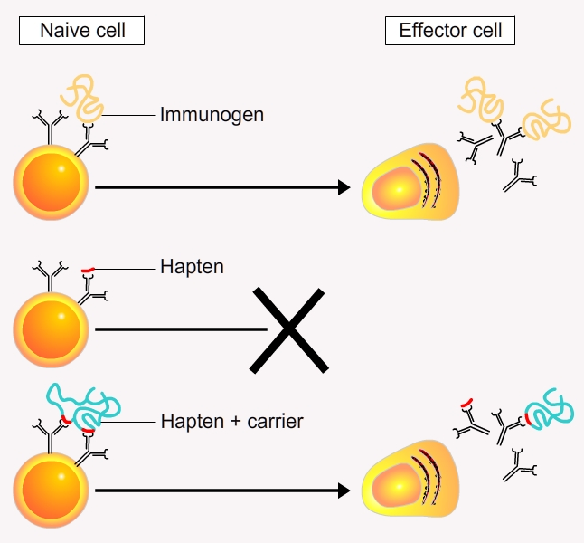
Features of antigen recognition: What is an antigen?
Definition
Antigen: any substance that is recognized by T or B lymphocytes via their cell surface receptors and/or antibodies secreted by B cells
Epitope: domain of the antigen that is recognized by immunoglobulins
Nature
proteins & glycoproteins
polysaccharides
lipoproteins & lipopolysaccharides
nucleic acids
chemical compounds (heavy metals, narcotics)

Slide 17
Features of antigen recognition: What is an antigen?
Foreignness
Self antigens (autoantigens): all antigens that are normal constituents of the body
Non-self antigens: all antigens that are not normal constituents of the body
Allogens: different antigens but same species
Exogens: antigens from other species
Immunogenicity
Immunogens: antigens that are able to stimulate a specific adaptive immune response when introduced into the body. Not all antigens are immunogens.
Haptens are small molecules that need a carrier to be immunogenic.

Slide 18
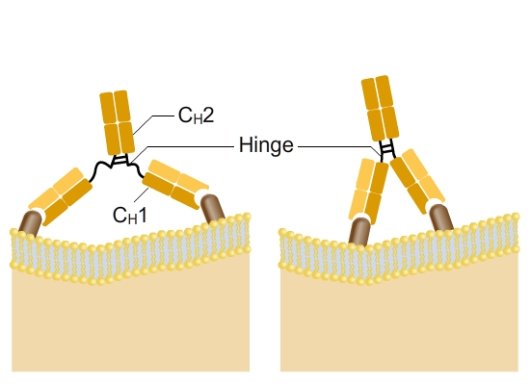
Features of antigen recognition (I): Flexibility
Adapted from Abbas, Cellular and Molecular Immunology

Slide 19
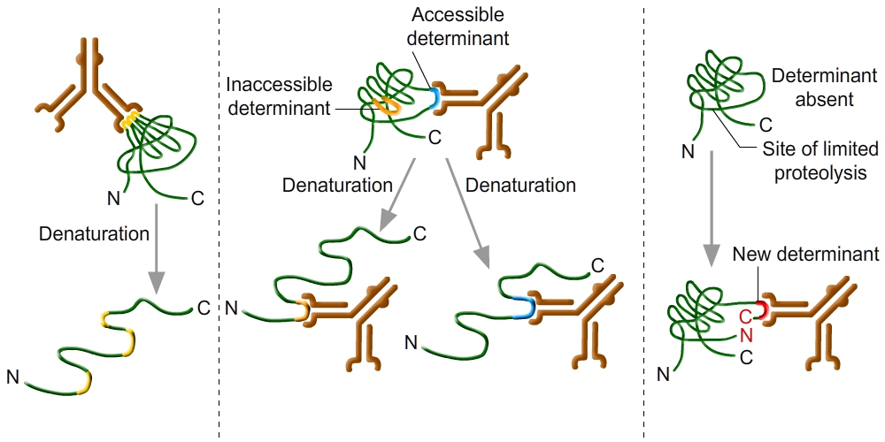
Features of antigen recognition (II): linear or conformational epitopes
Conformational
determinant
Linear
determinant
Neotenic
determinant
Recognition is lost upon denaturation
Ig binds only to denaturated protein
Ig binds to both native and denaturated protein
Proteolysis reveals the determinant recognized by the Ig
Adapted from Abbas, Cellular and Molecular Immunology

Slide 20
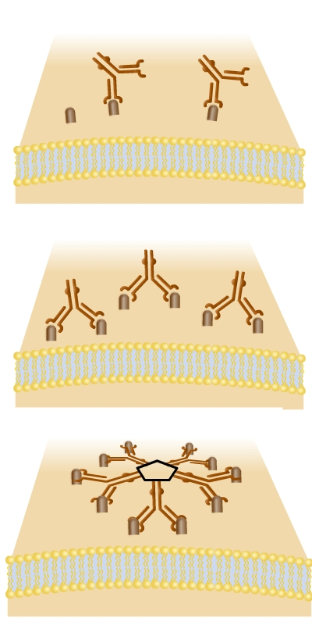
Features of antigen recognition (III):
Valency, affinity and avidity
Avidity
Monovalent antigens will interact with a single binding site of one antibody molecule. Although the affinity of this interaction may be high, the overall avidity may be relatively low.
When repeated determinants on a cell surface are close enough, both antigen-binding sites of a single IgG molecule can bind, leading to a higher-avidity bivalent interaction.
Monovalent
+/-
Bivalent
++
Polyvalent
+++
Adapted from Abbas, Cellular and Molecular Immunology

Slide 21
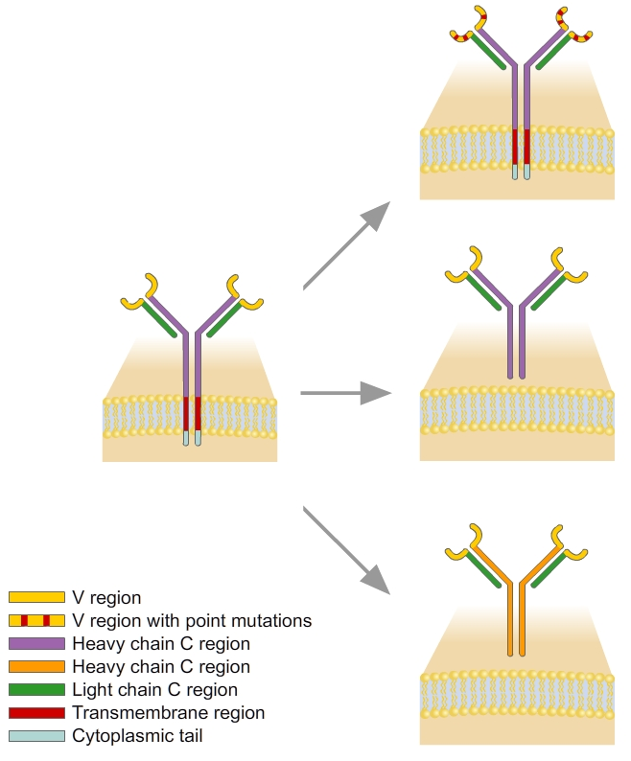
Features of antigen recognition (IV):
Changes in antibody structure during immune response
Affinity maturation (somatic mutation in the variable region → increased affinity)
Switch from membrane to secreted form
Isotype switching (change of the constant region → change effector function)
Adapted from Abbas, Cellular and Molecular Immunology

Slide 22
Summary | Features of antigen recognition
EPITOPE: An antibody binds to only a portion of the macromolecule, which is called a determinant or an epitope. The presence of multiple identical determinants in an antigen is referred to as polyvalency or multivalency. Most globular proteins do not contain multiple identical epitopes and are not polyvalent, unless they are in aggregates. In the case of polysaccharides and nucleic acids, many identical epitopes may be regularly spaced, and the molecules are said to be polyvalent. Polyvalent antigens can induce clustering of the B cell receptor and thus initiate the process of B cell activation.
LINEAR/CONFORMATIONAL EPITOPES: Epitopes formed by several adjacent amino acid residues are called linear determinants. The antigen-binding site of an antibody usually accommodates a linear determinant made up of about six amino acids. In contrast, conformational determinants are formed by amino acid residues that are not in a sequence but become spatially juxtaposed in the folded protein.
AVIDITY: Although the affinity of any one antigen-binding site will be the same for each epitope of a polyvalent antigen, the strength of attachment of the antibody to the antigen must take into account binding of all the sites to all the available epitopes. This overall strength of attachment is called the avidity and is much greater than the affinity of any one antigen-binding site. Thus, a low-affinity IgM molecule can still bind tightly to a polyvalent antigen because many low-affinity interactions (up to 10 per IgM molecule) can produce a single high-avidity interaction.
SPECIFICITY: The fine specificity of antibodies applies to the recognition of all classes of molecules. However, some antibodies produced against one antigen may bind to a different but structurally related antigen (cross-reaction).
DIVERSITY: An individual is capable of making a tremendous number of structurally distinct antibodies, perhaps up to 10⁹, each with a distinct specificity. The total collection of antibodies with different specificities represents the antibody repertoire.
AFFINITY MATURATION: A mechanism for the generation of high-affinity antibodies involves subtle changes in the structure of the V regions of antibodies during T cell-dependent humoral immune responses to protein antigens. These changes come about by a process of somatic mutation in antigen-stimulated B lymphocytes that generates new V domain structures, some of which bind the antigen with greater affinity than did the original V domains. Those B cells producing higher-affinity antibodies preferentially bind to the antigen and, as a result of selection, become the dominant B cells with each subsequent exposure to the antigen. Thus, an antibody produced during a primary immune response to a protein antigen often has a Kd in the range of 10⁻⁷ to 10⁻⁹ M; in secondary responses, the affinity increases, with a Kd of 10⁻¹¹ M or even less.

Slide 23
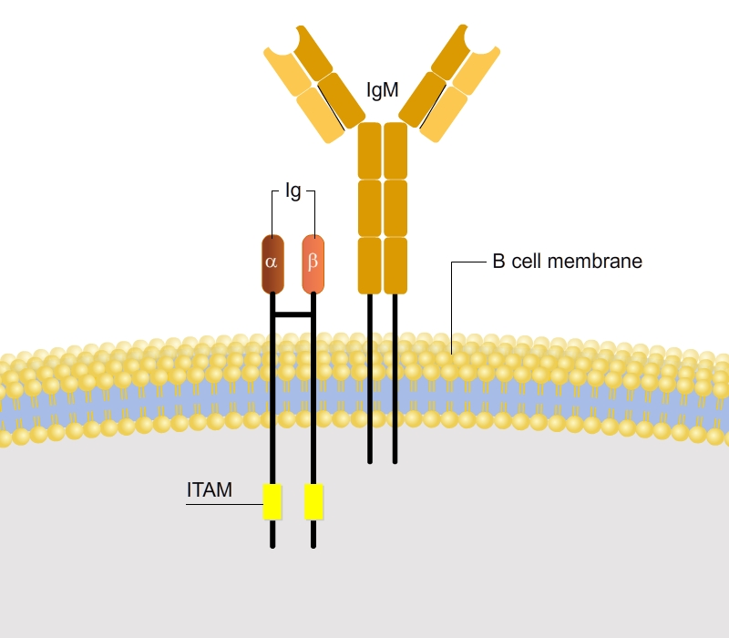
The B cell co-receptor
ITAM:
Immunoreceptor Tyrosine based Activating Motif
Short cytoplasmic domain: no signaling activity

Slide 24

Structure of the T cell antigen receptor (TCR)
Antigen-Binding site
Variable
regions
V
V
Constant
regions
C
C
 chain
 chain
Disulfide bridge
T cell receptor

Slide 25
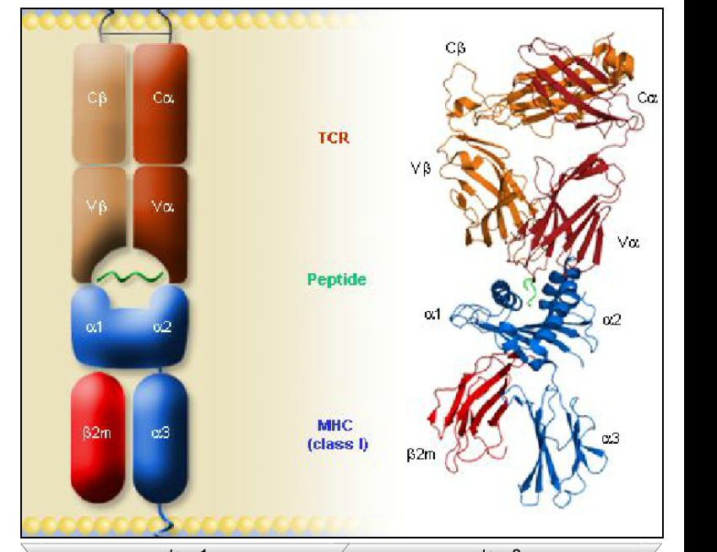
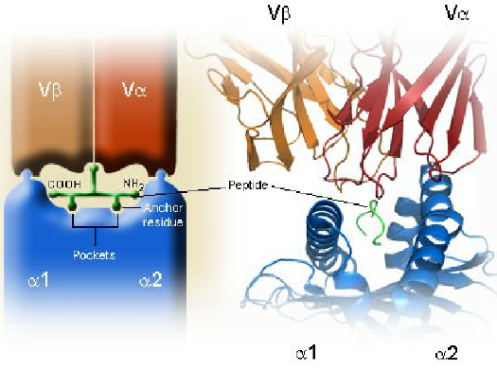
Recognition of a peptide-MHC complex by a T cell antigen receptor
TCR
peptide
MHC
(class I)
Schematic representation (left) and X-ray crystal structure (right) of a TCR interacting with a human class I MHC molecule, HLA-A2, presenting the Saccharomyces cerevisiae peptide Tel1p (PDB entry: 3h9s).

Slide 26
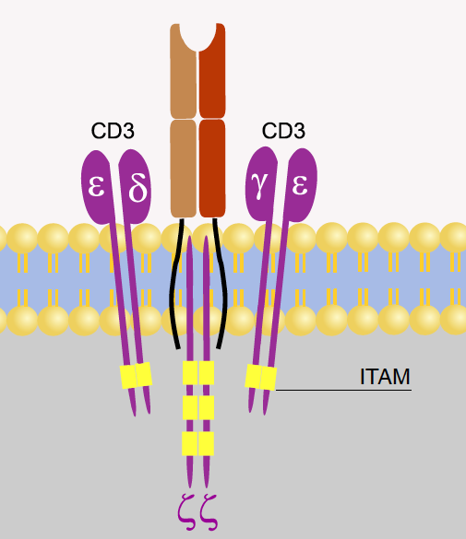
Structure of the TCR and associated membrane molecules
CD3 Complex Structure:
Group of four invariant proteins (2 CD3ε chains, one CD3δ and one CD3γ chain) associated with TCR
Functions:
synthesized co-ordinately with TCR, required to bring TCR to surface
transduces activating signals to T cell when TCR recognizes MHC-peptide

Slide 27
Summary | T cell receptors
The TCR for peptide antigen displayed by MHC molecules is a membrane-bound heterodimer composed of an α chain and a β chain, each chain containing one variable (V) region and one constant (C) region
Both the α chain and the β chain of the TCR participate in specific recognition of MHC molecules and bound peptides
The TCR recognizes antigen, but like membrane Ig on B cells, is incapable of transmitting signals to the T cell. Associated with the TCR is a complex of proteins, called the CD3 and ζ proteins, that make up the TCR complex. The CD3 and ζ chains transmit some of the signals that are initiated when the TCR recognizes antigen. In addition, T cell activation requires engagement of the coreceptor molecules, CD4 or CD8, which recognize nonpolymorphic portions of MHC molecules and also transmit activating signals.

Slide 28
Other lymphocytes: γδ T Cells and NK-T Cells
γδ T Cells
NK-T Cells
5% to 10% of T cells
express receptors composed of γ and δ chains, which are structurally similar to the αβ TCR but have very different specificities
recognize a variety of protein and non-protein (glycolipid) antigens, usually not displayed by classical MHC molecules
abundant in epithelia
Quasi innate immune cells
These observations suggest that γδ T cells recognize microbes that are commonly encountered at epithelial surfaces, but neither the specificity nor the function of these T cells is well established.
<5% of T cells
express markers of natural killer (NK) cells
express αβ TCRs, but recognize lipid antigens displayed by non-polymorphic class I MHC-like molecules.
functions of NK-T cells are not well understood

Slide 29
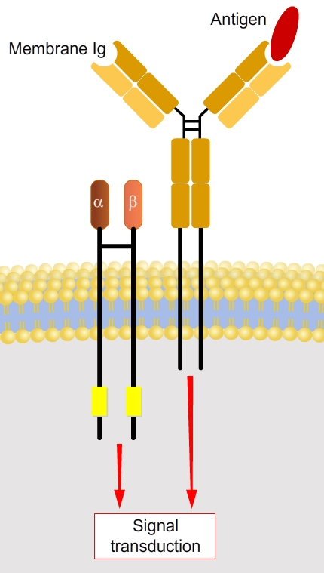
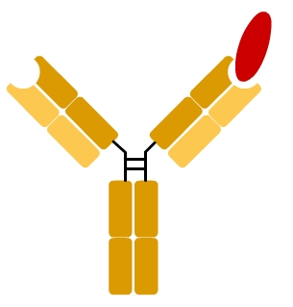
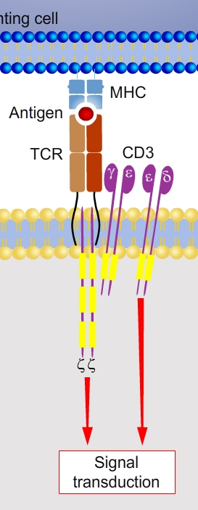
Conclusions | Similarities and differences between
B and T cell receptors
Antibodies (BCRs) are formed of two H and two L chains. They can be expressed as membrane receptors or secreted proteins. TCRs are formed of α and ß chains. They only function as membrane receptors.
TCR and BCR both contain constant and variable regions. Variable regions of both chains form the antigen binding site.
Antibodies can recognize native antigens (linear or conformational) while TCRs recognize only small peptides (linear) displayed by MHC
When immunoglobulin or TCR molecules recognize antigens, signals are delivered to the lymphocytes by proteins associated with the antigen receptors.
Signaling requires the cross-linking of two or more receptors by binding to adjacent antigen molecules.
BCR and secreted antibodies
TCR

Slide 30
Summary | Lymphocyte antigen receptors
The antigen receptors of B and T lymphocytes recognize chemically different structures.
B lymphocyte antigen receptors (membrane-bound antibodies) and antibodies recognize the shapes of native macromolecules (proteins, lipids, carbohydrates, and nucleic acids, simple small chemical groups and parts of macromolecules).
Most T cells see only peptides, and only when these peptides are displayed on antigen-presenting cells (APCs) bound to membrane proteins encoded in the major histocompatibility complex (MHC) genetic locus. Thus, T cells are able to detect cell-associated microbes.
Antigen receptor molecules consist of domains involved in either antigen recognition (variable between clones of lymphocytes) and other regions that are required for effector functions (conserved among all clones). The antigen-recognizing portions of the receptors are called the variable (V) regions, and the conserved portions are the constant (C) regions. Even within the V regions, much of the sequence variability is concentrated within short stretches, which are called hypervariable regions, or complementarity-determining regions (CDRs), because they form the parts of the receptor that bind antigens.
Antigen receptors are non-covalently attached to other molecules whose function is to transmit the activation signals upon antigen recognition to the inside of the cell. Thus, the two functions of lymphocyte antigen receptors - specific antigen recognition and signal transduction - are mediated by different polypeptides: B cell receptor (BCR) complex, and T cell receptor (TCR) complex. Binding to two or more antigen molecules aggregates the receptors → close proximity of the cytoplasmic portions of the signaling proteins → phosphorylation → complex signaling cascades → transcriptional activation of many genes and the production of numerous proteins that mediate the responses of the lymphocytes.
Antibodies (also called immunoglobulins, Igs) may be membrane-bound antigen receptors of B cells or secreted proteins, but TCRs exist only as membrane receptors of T cells.

Slide 31
III-2
Development of Immune Repertoires
Production of B and T cell receptors by somatic recombination
  Principles and discovery
  Antigen receptor locus organization
  VDJ recombination
  Junctional diversity
  Summary
Maturation of B and T cells
  Maturation of B cells
  Allelic exclusion
  Maturation of T cells

Slide 32
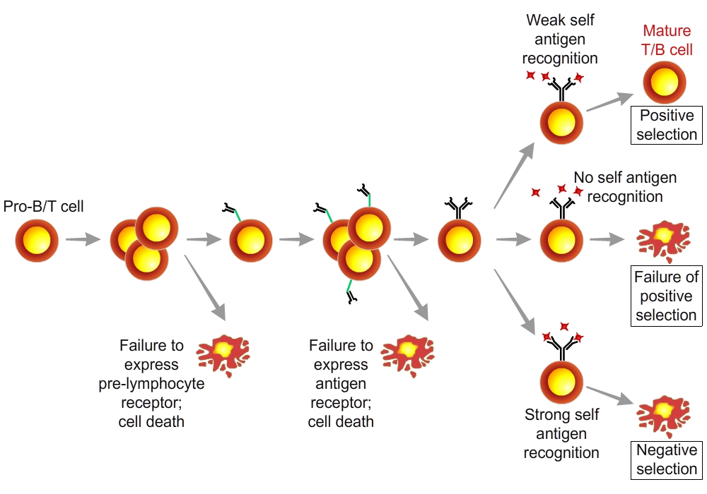
Overview: lymphocyte maturation
Lymphocytes mature from bone marrow stem cells in three steps:
proliferation of immature cells,
expression of antigen receptor genes by gene recombination
selection of lymphocytes that express useful antigen receptors
Positive and negative selection
These steps are common to B and T lymphocytes, although B lymphocytes mature in the bone marrow and T lymphocytes mature in the thymus.
Antigen receptor expression
Proliferation
Pre-B/T antigen receptor expression
Proliferation
Pro-B/T cell
Adapted from Abbas, Cellular and Molecular Immunology

Slide 33
Principles of antibody production by somatic recombination
Finding: almost every immunoglobulin variable region sequence was unique to a specific antibody; constant region sequences were composed out of one of a number of invariant sequences
This combination of constancy and enormous variation is possible due to the particular genetic organization of immunoglobulin genes.
In germ-line DNA, multiple gene segments are present („string of pearls“) that eventually will contribute to a specific Ig gene.
The germ-line organization of the Ig-gene fragments does not allow the expression of a functional Ig gene; genomic rearrangement of the Ig gene fragments is a prerequisite for the functional expression of Igs.
Genomic Ig gene rearrangement is a random process of joining different gene segments on a genomic level. The diversity created by this random joining of gene fragments is further increased by multiple mechanisms to create an estimated 10⁸⁻⁹ different Ig specificities.
Thus mature B cells contain DNA whose Ig locus is no longer identical to the germ-line organization.

Slide 34
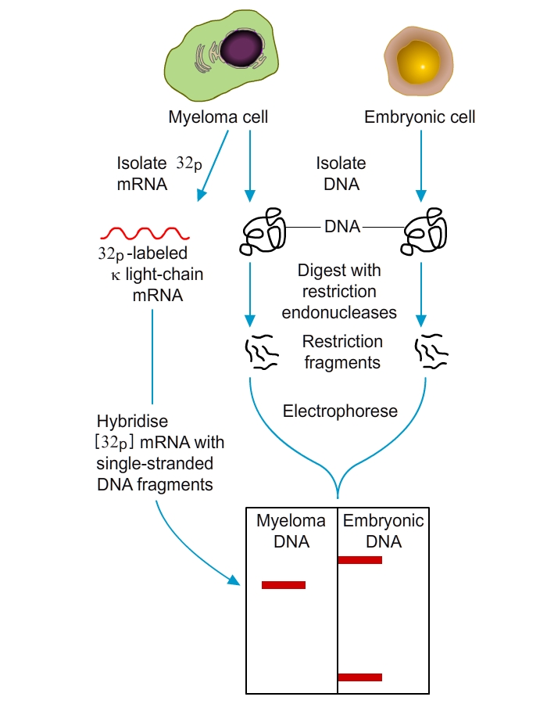
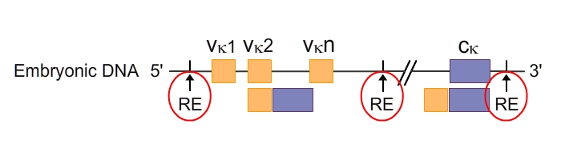
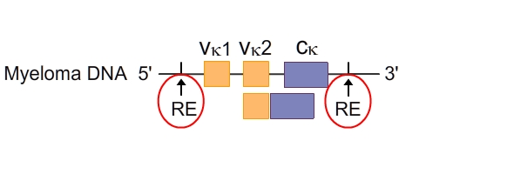
Classical experiment by Susumu Tonegawa (Nobel 1987)
DNA was isolated from embryonic cells or adult myeloma cells
Digestion of DNAs with various restriction enzymes
Electrophoresis and hybridization with labelled κ-light chain mRNA from myeloma cell

Slide 35
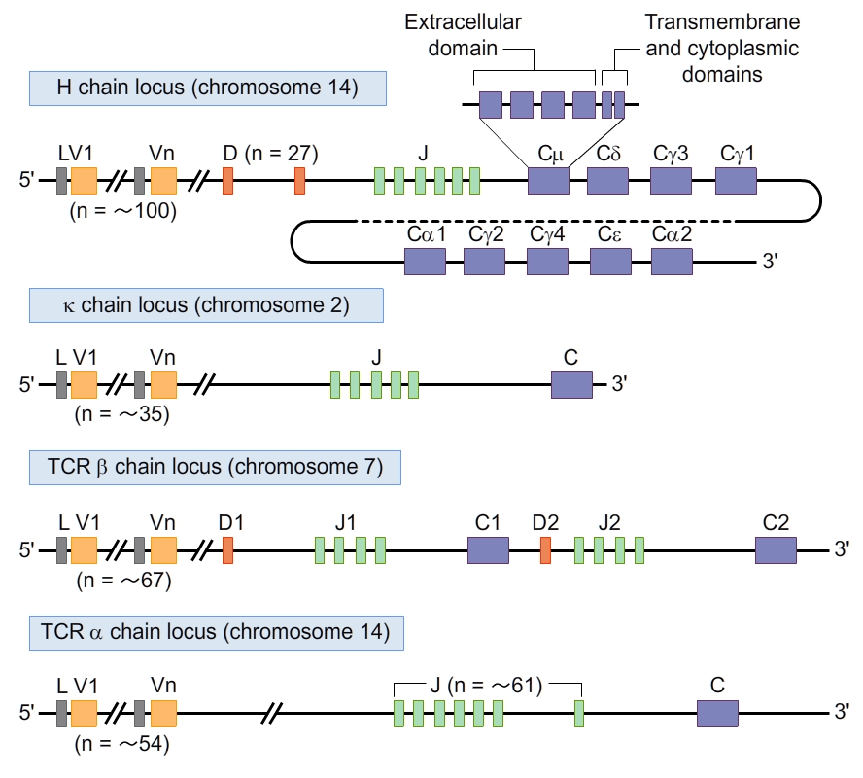
Germline organization of antigen receptor gene loci
In the germline, antigen receptor gene loci contain exons (shown as blocks of various sizes) that are separated by introns (shown as lines).
Each Ig heavy chain constant (C) region and TCR C region consists of multiple exons that encode the domains of the C regions (the organization of the Cm exon in the Ig heavy chain locus is shown as an example).
Antigen receptor gene loci in humans, not drawn to scale.
L, leader sequence (a small stretch of nucleotides that encodes a peptide that guides proteins through the endoplasmic reticulum and is cleaved from the mature proteins); C, constant; D, diversity; J, joining; V, variable.
Adapted from Abbas, Cellular and Molecular Immunology

Slide 36
Variable region gene rearrangements
Recombination event at the level of genomic DNA (only site-specific DNA rearrangements in vertebrates)
Occurs during B cell development in bone marrow
Random genomic rearrangement that occurs in ordered fashion
1st: heavy chain V-gene rearrangement; 2nd: light chain V-gene rearrangement
Antigen specificity is determined by V-region rearrangements

Slide 37
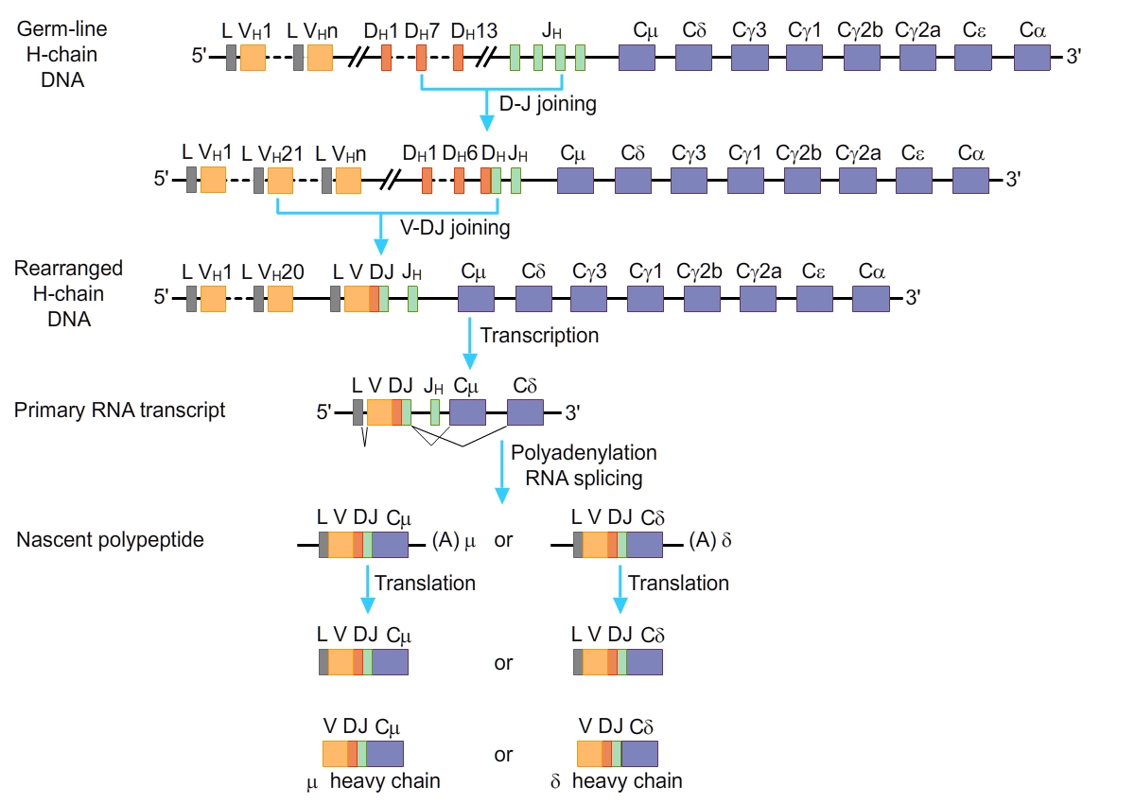
Heavy chain: V-D-J rearrangement
The expression of an Ig heavy chain involves two recombination events (D-J joining, followed by joining of a V region to the DJ complex, with deletion and loss of intervening gene segments). The recombined gene is transcribed, and the VDJ segment is spliced onto the first heavy chain RNA (which is μ). The mRNA is translated to produce the μ heavy chain protein. The recombination of other antigen receptor genes (Ig light chain and the TCR α and ß chains) follows essentially the same sequence, except that in loci lacking D segments (Ig light chains and TCR α), a V gene recombines directly with a J gene segment. TCR, T cell receptor.
Mature naive B cell expresses membrane-bound IgM and IgD

Slide 38
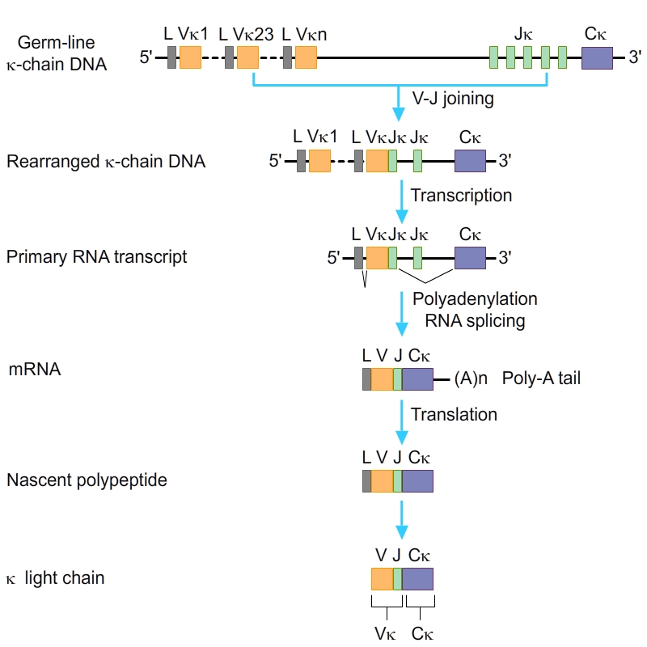
Light chain: V-J rearrangement (here: κ-locus)

Slide 39
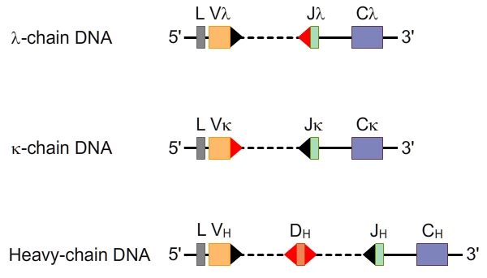
Mechanism of V-region rearrangement
Presence of unique recombination signal sequences (RSS) which flank V, D and J gene segments
RSS function as signal sequences for recombination process by V (D) J recombinases called RAG-1 and RAG-2 (RAG=recombination-activating genes)
Two Turn RSS
One Turn RSS

Slide 40
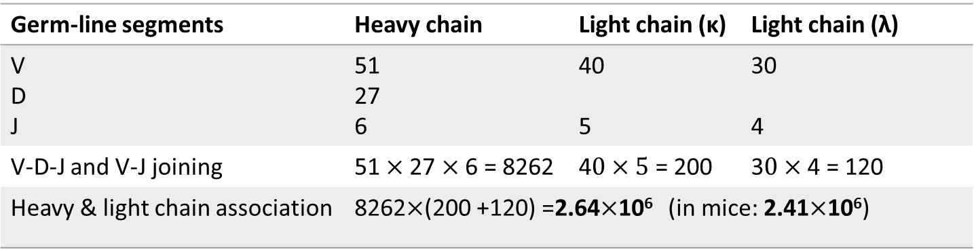
Combinatorial antibody diversity
Germ-line segments | Heavy chain | Light chain (κ) | Light chain (λ)
V D J | 51 27 6 | 40 5 | 30 4
V-D-J and V-J joining | 51$×$27 $×$ 6 = 8262 | 4$0×5$ = 200 | 3$0×$4 = 120
Heavy & light chain association | 8262$×$(200 +120) =2.64$×$10⁶ (in mice: 2.41$×$10⁶)
Estimated number of segments in humans
Junctional diversity and somatic mutations may increase this number by several orders of magnitude

Slide 41
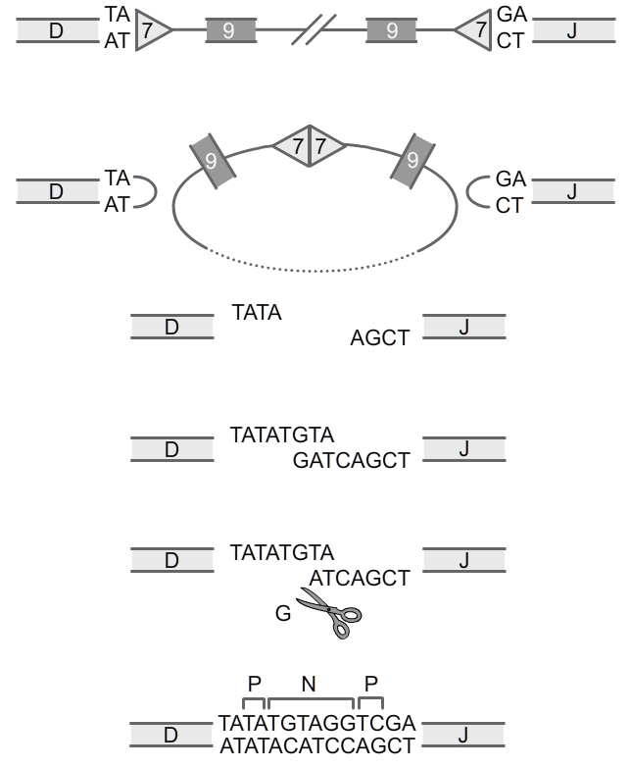
Junctional Diversity
Cleavage of dsDNA by RAG1 and RAG2
Formation of a hairpin
Random hairpin cleavage by an endonuclease that generates P nucleotides
Addition of N nucleotides by the terminal-desoxynucleotidyl-transferase (TdT)
Junction of coding segment by DNA matching and deletion of non-matching nucleotides
DNA synthesis and ligation
Adapted from Espinosa

Slide 42
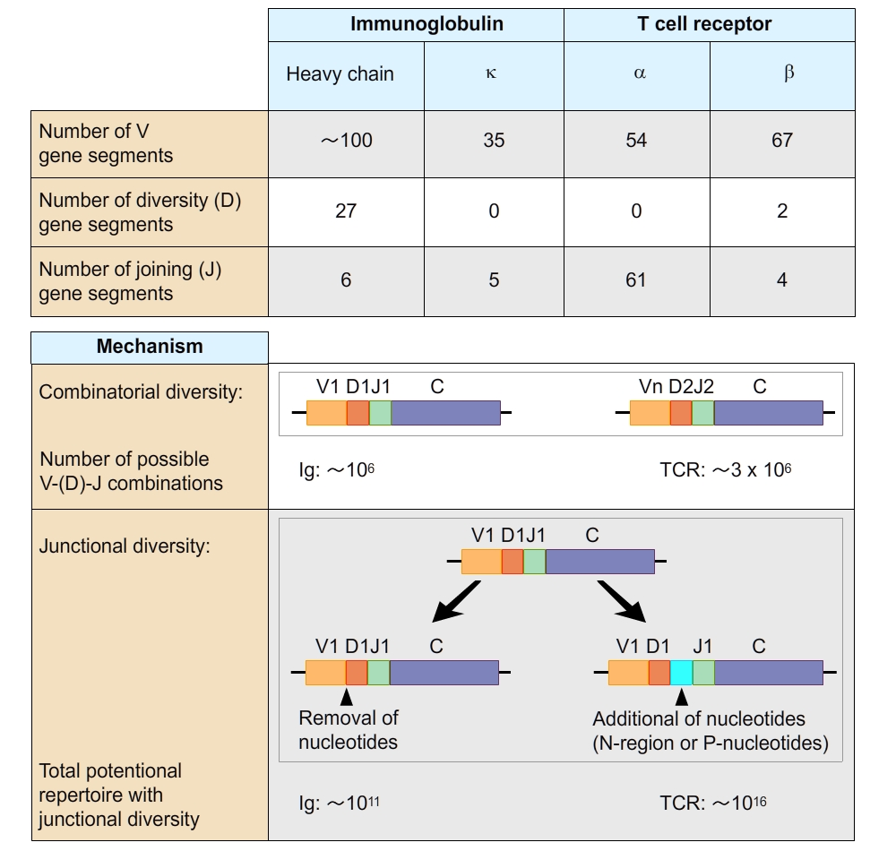
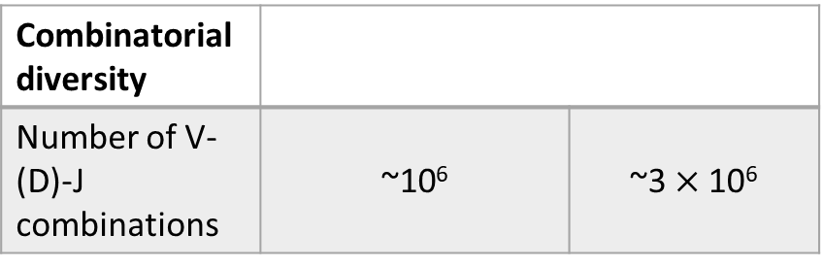
Combinatorial and junctional diversities in antigen receptors
 | Ig |  | TCR
Number of segments | Heavy chain | κ | α | β
V | 51 | 40 | 54 | 67
D (diversity) | 27 | - | - | 2
J (joining) | 6 | 5 | 61 | 4
Diversity in immunoglobulins and T cell receptors (TCRs) is produced:
  by random combinations of V, D, and J gene segments (combinatorial diversity)
  by removal and addition of nucleotides at the V-J or V-D-J junctions (junctional diversity)
Both mechanisms maximize diversity in the 3 CDR regions of the antigen receptors.
Diversity is increased by the ability of different Ig heavy and light chains, or different TCR chains, to associate in different cells, forming different receptors (not shown).
Only a fraction of the potential repertoire may actually be expressed.
Combinatorial diversity
Number of V-(D)-J combinations | ~10⁶ | ~3 $×$10⁶
Junctional diversity
Total potential repertoire | ~10¹¹ | 10¹⁶
Adapted from Abbas, Cellular and Molecular Immunology

Slide 43
Summary | Generation of antigen receptor diversity
The expression of B and T lymphocyte antigen receptors is initiated by somatic recombination of gene segments that code for the variable regions of the receptors.
The somatic recombination of V, (D,) and J, gene segments is mediated by the VDJ recombinase, which is composed of the recombinase-activating gene (RAG)-1 and RAG-2 proteins. They recognize DNA sequences that flank all antigen receptor V, D, and J gene segments and bring the V, D, and J segments close together by cleaving the DNA at specific sites. The DNA breaks are then repaired by ligases, producing a full-length recombined V-J or V-D-J gene without the intervening DNA segments. The lymphoid-specific component of the VDJ recombinase is expressed only in immature B and T lymphocytes. Although the same enzymes can mediate recombination of all Ig and TCR genes, intact Ig heavy and light chain genes are expressed only in B cells, and TCR α and β genes are expressed only in T cells.
Diversity of antigen receptors is produced by the use of different combinations of V, D, and J gene segments in different clones of lymphocytes (combinatorial diversity) and increased by changes in nucleotide sequences introduced at the junctions of V, D, and J gene segments (junctional diversity). This junctional diversity is produced by three types of sequence changes, each of which generates more sequences than are present in the germline genes. First, exonucleases may remove nucleotides from V, D, and J gene segments at the time of recombination, and if the resulting recombined sequences do not contain stop or nonsense codons, many different and new sequences may be produced. Second, a lymphocyte-specific enzyme called terminal deoxyribonucleotidyl transferase (TdT) catalyzes the random addition of nucleotides that are not part of germline genes to the sites of V(D)J recombination, forming so-called N regions. Third, during an intermediate stage in the process of V(D)J recombination, before breaks in the DNA are repaired, overhanging DNA sequences may be generated that are then filled in by "P-nucleotides," introducing even more variability at the sites of recombination. These junctional sequences encode the amino acids of the CDR3 loop, the most variable of the CDRs and the one most important for antigen recognition. Thus, junctional diversity maximizes the variability in the antigen-binding regions of antibodies and TCRs.
In the process of creating junctional diversity, many genes may be produced that cannot code for proteins and are therefore useless. This is a price the immune system pays for generating tremendous diversity. The risk of producing non-functional genes is why the process of lymphocyte maturation contains several checkpoints at which only cells with useful receptors are selected to survive.

Slide 44
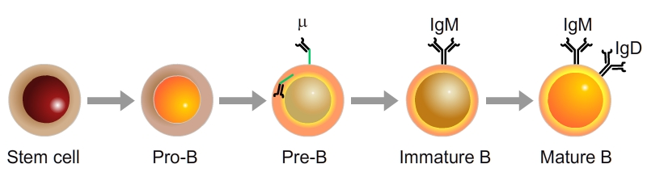
Maturation and selection of B lymphocytes
Bone marrow
Negative
Selection
Recombination heavy chain
(μ mRNA)
Recombination light chain
(λ or κ mRNA)
Alternative splicing
to form
Cδ and Cμ mRNA
‘Receptor editing’
B lymphocytes mature through sequential steps:
Cell proliferation gives rise to a large set of progenitors (pro-B cells)
Pro-B cells mature into pre-B cells by recombination of the heavy chain (μ chain) (which is expressed at the membrane with surrogate proteins)
checkpoint 1: a non-functional μ chain triggers apoptosis while the presence of a functional μ chain triggers allelic exclusion
Pre-B cells mature into immature B cells when the λ or κ light chain locus produces a complete membrane associated IgM
checkpoint 2: functional IgM promotes cell survival and shuts off recombinase expression. Negative selection: immature B cells with high affinity to an antigen of the bone marrow (mostly self antigens) die or reactivate the VDJ recombinase to produce a new light chain
Mature B cells co-express IgD and IgM

Slide 45
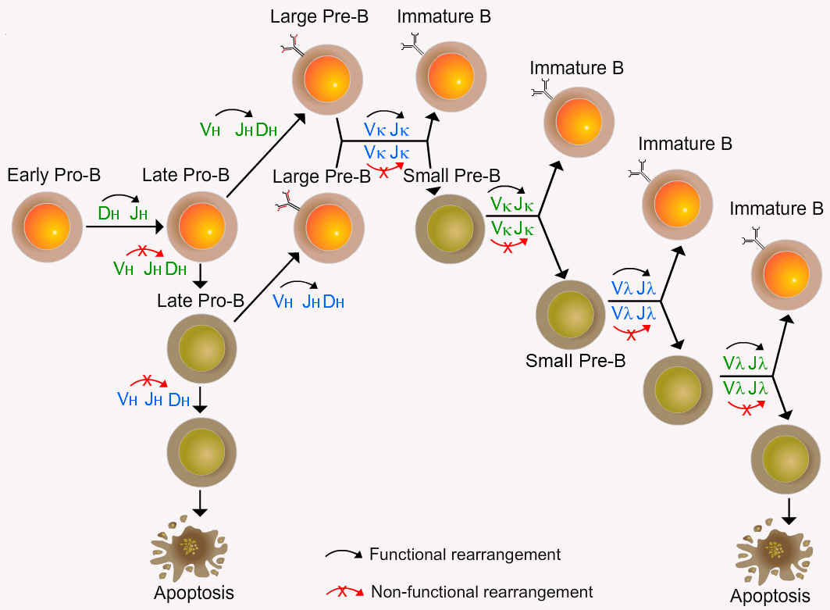
B lymphopoiesis: allelic exclusion
Allelic exclusion acts by preventing the rearrangement of the second allele when the rearrangement of the first one (either maternal or paternal) has been successful.
Mediated by down-regulation of RAG-1/RAG-2 once productive H and L-chain rearrangements are achieved
Applies to both the heavy- and light-chain genes
Ensures that mature B cells express a single B-cell receptor.

Slide 46
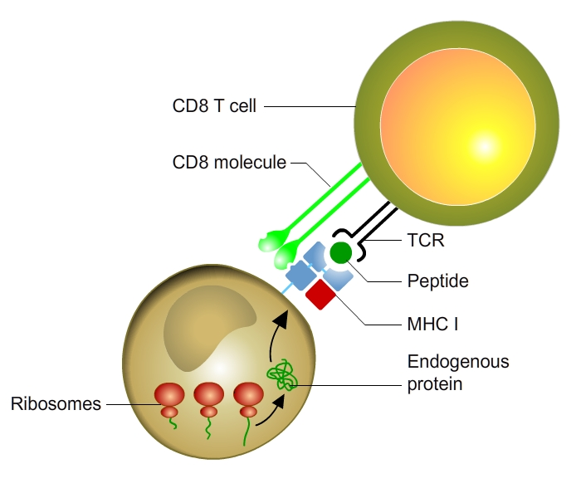
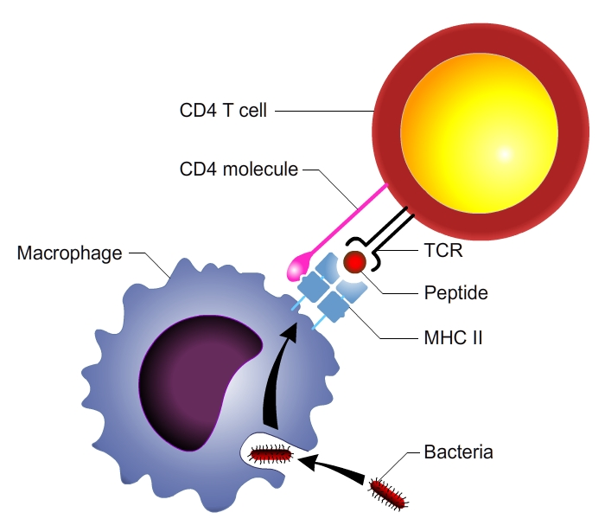
Maturation of T cells: 2 types of T cells
CD8 T cells
CD4 T cells

Slide 47
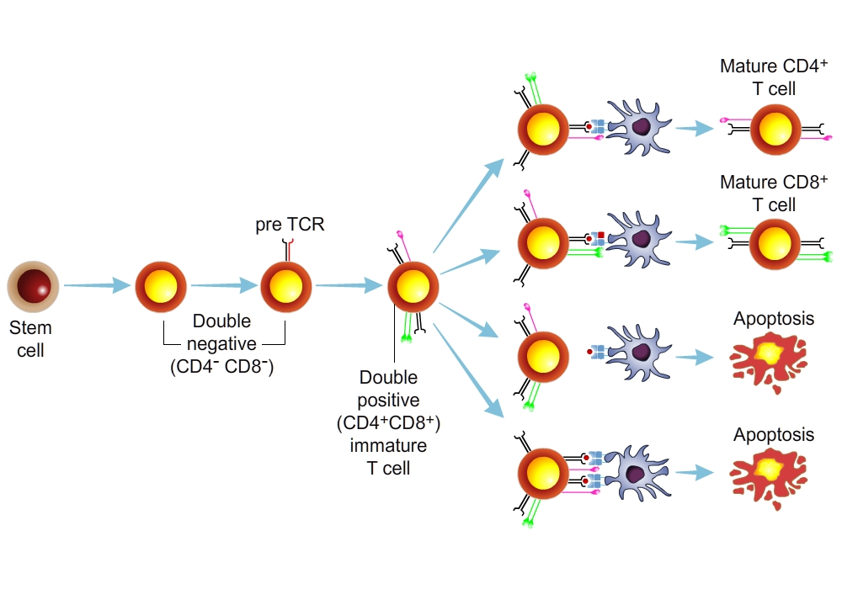
Maturation of T cells
Positive selection
Negative selection
T lymphocytes mature in the thymus through sequential steps defined by the expression of the CD4 and CD8 co-receptors.
The TCR β chain is first expressed in double-negative pre-T cells. The complete TCR is expressed in double-positive T cells.
Maturation culminates in the development of CD4⁺ and CD8⁺ single-positive T cells.
As in B cells, failure to express antigen receptors at any stage leads to death of the cells by apoptosis.

Slide 48
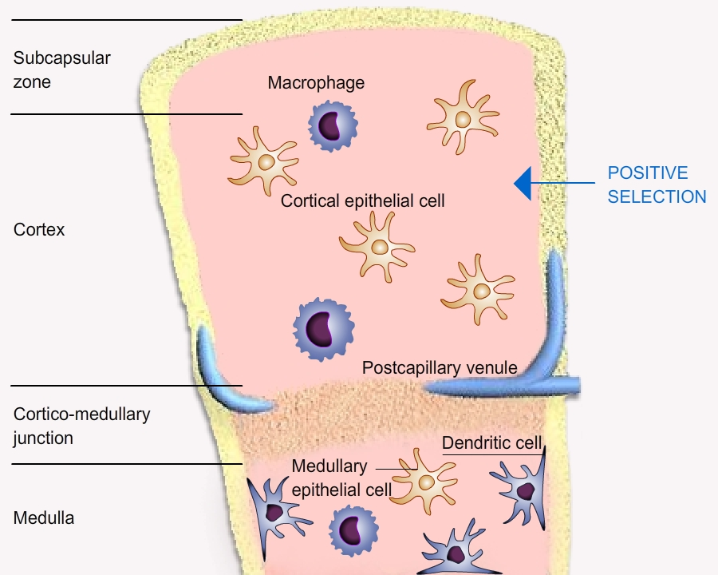
Maturation of T cells: positive selection

Slide 49
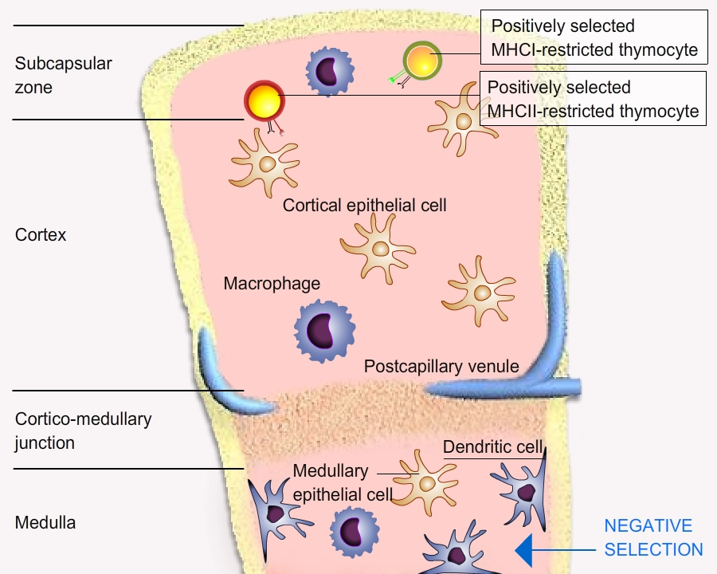
Maturation of T cells: negative selection

Slide 50
Maturation of T cells
Positive selection
Negative selection
T lymphocytes mature in the thymus through sequential steps defined by the expression of the CD4 and CD8 co-receptors.
The TCR β chain is first expressed in double-negative pre-T cells. The complete TCR is expressed in double-positive T cells.
Maturation culminates in the development of CD4⁺ and CD8⁺ single-positive T cells.
As in B cells, failure to express antigen receptors at any stage leads to death of the cells by apoptosis.

Slide 51
Summary | Maturation of T cells
The process of T lymphocyte maturation has some unique features, which are largely related to the specificity of different subsets of T cells for peptides displayed by different classes of MHC molecules.
T Cell maturation: T cell progenitors migrate from the bone marrow to the thymus, where the entire process of maturation occurs. The most immature progenitors are called pro-T cells or double-negative T cells because they do not express CD4 or CD8. These cells expand in number mainly under the influence of IL-7 produced in the thymus. Some of the progeny of double-negative cells undergo TCR β gene recombination, mediated by the V(D)J recombinase. If successful VDJ recombination takes place on one chromosome and a β chain protein is synthesized, it is expressed on the surface in association with an invariant protein called pre-Tα, to form the pre-TCR complex of pre-T cells. If the complete β chain is not produced in a pro-T cell, that cell dies. The pre-TCR complex delivers intracellular signals to promote survival, proliferation, and TCR α gene recombination, and inhibit VDJ recombination in the second TCR β chain locus (allelic exclusion). Failure to express the α chain and the complete TCR again results in death of the cell. The surviving cells express both the CD4 and CD8 co-receptors, and these cells are called double-positive T cells (or double-positive thymocytes).
Positive selection: Different clones of double-positive T cells express different αβ TCRs. If the TCR of a T cell recognizes an MHC molecule in the thymus, which has to be a self MHC molecule displaying a self peptide, that T cell is selected to survive. T cells that do not recognize an MHC molecule in the thymus die by apoptosis; these T cells would not be useful because they would be incapable of seeing MHC-displayed cell-associated antigens in that individual. During this process, T cells whose TCRs recognize class I MHC-peptide complexes preserve the expression of CD8, the co-receptor that binds to class I MHC, and lose expression of CD4, the coreceptor specific for class II MHC molecules. Conversely, if a T cell recognizes class II MHC-peptide complexes, that cell maintains expression of CD4 and loses expression of CD8. Thus, what emerges are single-positive T cells, which are either CD8+ class I MHC restricted or CD4+ class II MHC restricted. During this process, the T cells also become functionally segregated: The CD8+ T cells are capable of becoming CTLs on activation, and the CD4+ cells are helper cells.
Negative selection: Immature, double-positive T cells whose receptors strongly recognize MHC-peptide complexes in the thymus undergo apoptosis. This is the process of negative selection, and it serves to eliminate T lymphocytes that could react in a harmful way against self proteins that are expressed in the thymus.

Slide 52
Conclusions | Generation of a repertoire of antigen recognition receptors
Genomic Ig and TCR gene rearrangement is a random process of joining different gene segments on genomic DNA level.
This combinatorial diversity is further increased by junctional diversity.
Generating antigen receptors is wasteful.
Sequential gene recombination and allelic exclusion ensures that mature B an T cells express a single antigen receptor.
Negative selection ensures that immature B or T cells with high affinity to self antigens are blocked: they die or reactivate the VDJ recombinase to produce a new light chain.
Positive selection ensures that TCR molecules recognize self MHC and leads to the production of T CD8 and T CD4 single positive cells.

Slide 53
III-3
Organs and tissues of the immune system
Primary lymphoid organs
  Bone marrow
  Thymus
Secondary lymphoid organs
  lymph nodes
  Spleen
  Mucosa-associated lymphoid tissue (MALT)

Slide 54
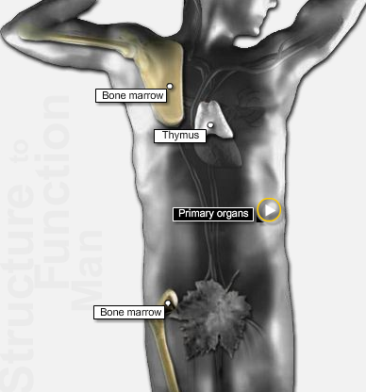
Primary lymphoid organs
Lymphoid organs are divided into primary and secondary (peripheral) organs.
Primary lymphoid organs are the sites where leukocytes are generated and include
the bone marrow, where haematopoiesis takes place and B lymphocytes are generated
the thymus, where T cells proliferate; differentiate and mature

Slide 55
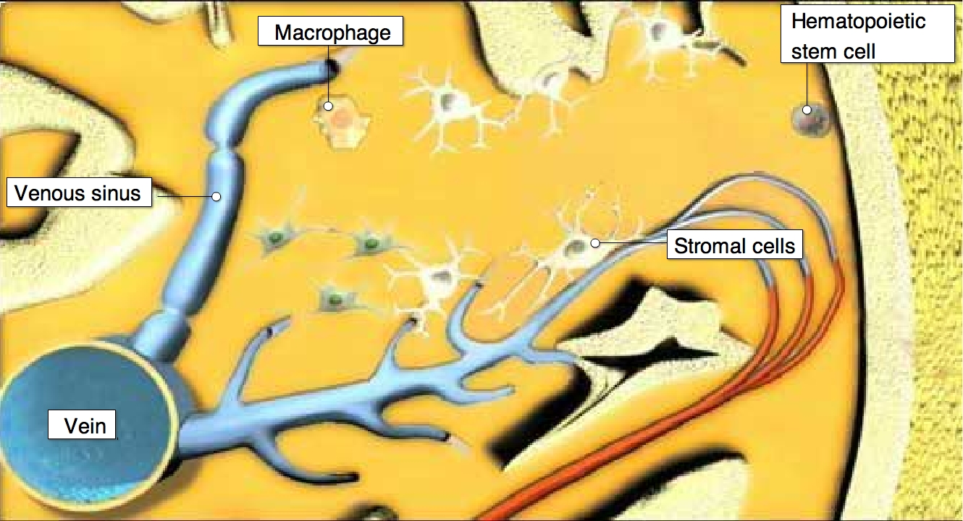
Generation of the leukocyte lineages
All leukocytes circulating in blood originate from stem cells in the bone marrow.
The process that allows differentiation and maturation of leukocytes from stem cells is called hematopoiesis.
Hematopoiesis is divided in two main arms:
  Lymphopoiesis, which generates lymphocytes
  Myelopoiesis, which generates
    Granulocytes
    Monocytes
    Dendritic cells
    Platelets
    Erythrocytes

Slide 56


The red bone marrow: lymphopoeisis
Red bone marrow
located in the bone cavities
red (hematopoietic) or yellow (fat, cartilage, and bone)
made of a stroma consisting of a network of reticular fibres containing hematopoietic cells
site of adult haematopoiesis
where B lymphocytes differentiate and acquire antigen-specific receptors
where auto-reactive B cells are eliminated
Spongy bone
marrow
yellow bone
marrow

Slide 57


Structure of the thymus
The thymus serves as the primary lymphoid organ for the development of T cells.
The adult mammalian thymus is a pyramid-shaped organ formed of two structurally identical lobes.
Lobules consist of a cortex and a medulla.
The thymic stroma consists of a network of epithelial cells that participate in the positive and negative selection.
Cortex
Cortical epithelial cell
thymocytes
macrophage
Medullary epithelial cell
Medulla
Dendritic cell

Slide 58

Thymocyte development
A video on T cell maturation in the thymus: https://www.youtube.com/watch?v=odLLr6mjaUQ

Slide 59

Intra-thymus trafficking
T lymphocyte progenitors produced in the bone marrow enter the thymus via the post-capillary venules.
Progenitors migrate to the cortex where they proliferate and rearrange their TCR genes, become double positive and express CD4 and CD8 co-receptors.
Double-positive thymocytes undergo positive selection.
They become single-positive and
express either CD4 or CD8 co-receptors.
Single-positive thymocyte migrate to the medulla where they undergo negative selection.
Mature CD4 and CD8 T cells leave the thymus through the post-capillary venules.

Slide 60

Secondary lymphoid organs
Secondary lymphoid organs are the sites where adaptive immune responses are initiated and include
  the lymph nodes
  the spleen
  the mucosa-associated lymphoid tissue (MALT)
Lymph nodes are secondary lymphoid organs in which naïve lymphocytes encounter antigens drained by afferent lymphatics.

Slide 61

Antigen sampling, part I
Skin Antigens encountered in the skin are sampled by DCs and transported through the afferent lymphatics to the draining LN for presentation to lymphocytes.
MALT Antigens encountered in MALT structures are sampled by M cells which pass on intact antigen to underlying DCs. From there, DCs move to the paracortical region of MALT for presentation to local lymphocytes.
Draining lymph nodes Antigens that enter epithelial tissues (skin and mucosae) and escape local sampling by DCs may be transported in soluble form through the afferent lymphatics to the draining LN. There antigens are sampled by local DCs for presentation to recirculating naïve T cells.

Slide 62
Antigen sampling, part II
Spleen Antigens that enter the bloodstream are sampled by DCs in the spleen.

Slide 63

The lymph nodes (LN)
The architecture of LNs is an ideal environment for lymphocytes to effectively encounter and respond to antigens.
Primary follicles mature to secondary follicles and germinal centers after antigen challenge.
3 domains:
  Cortex: lymphocytes (mostly B cells, macrophages and Follicular Dentritic cells (FDCs) in primary follicles)
  Paracortex: mainly T cells and DCs (migrated from tissues)
  Medulla: mainly Immunoglobulin-secreting plasma cells
Cortex
Paracortex
Medulla

Slide 64

Cell trafficking in lymph nodes: Dendritic Cells
HEV: High epithelial venules

Slide 65
Cell trafficking in lymph nodes: T Cells
HEV: High epithelial venules

Slide 66

The spleen consists of red and white pulp
The red pulp
participates in the clearance of cell debris and aged erythrocytes and leukocytes
is composed of macrophages, red blood cells (removal), few lymphocytes
The white pulp
acts as a secondary lymphoid organ able to trigger immune responses against blood-borne antigens.
surrounds branches of splenic artery, forming the periarteriolar lymphoid sheath (PALS).
is composed mainly of T cells. Primary B-cell follicles are attached to PALS and some contain germinal centers.
Splenic Vein
Splenic Artery
PALS
Primary B cell follicules

Slide 67
Leukocyte migration in the spleen
Blood-borne antigens enter the spleen via the splenic artery and are trapped by DCs in the PALS. DCs and lymphocytes enter through splenic artery.

Slide 68
The mucosa-associated lymphoid tissue (MALT)
The MALT is an organized lymphoid tissue associated with the mucosal tissues.
Not all mucosal tissues contain organized lymphoid tissues.
The MALT is present in the gastrointestinal and respiratory tracts, but not in the genital tract.
The MALT includes:
  the tonsils
  the GALT
    Peyer’s patches
    the appendix
    the follicles (colon & rectum)
  the BALT

Slide 69

Mucosa-associated lymphoid tissue (MALT)
Example: a Peyer’s patch in intestinal tissue
Role of M cells in intestinal antigen sampling

Slide 70
Mucosa-associated lymphoid tissue (MALT)
Example: a Peyer’s patch in intestinal tissue
Role of DCs in intestinal antigen sampling

Slide 71
Conclusions | Lymphoid organs
Lymphocytes continuously circulate between the blood and lymphoid organs.
Lymphoid organs are divided into:
  Primary lymphoid organs are the sites where leukocytes are generated and include
    the bone marrow: B and T cell progenitors, B cell maturation
    the thymus: T cell maturation
  Secondary lymphoid organs are the sites where adaptive immune responses are initiated and include
    the spleen
    the lymph nodes
    the mucosa-associated lymphoid tissue:
Secondary lymphoid organs are strategically located to sample antigens at various entry points (skin, blood, mucosae).
DCs and M cells have the ability to sample antigens from the intestinal lumen.

Slide 72
Objectives
Describe the structure of primary and secondary lymphoid organs :
  What is the cell composition and compartmentalisation of lymphoid tissues?
  How do immune cells reach and leave lymphoid organs?
Describe the organization of the bone marrow & thymus and explain how these structures allow the generation of the immune repertoire
  What are the steps involved in the differentiation and maturation of T and B cells?
  Name two types of quality control ensuring the elimination of self-reactive lymphocytes.
Describe the migratory patterns of monocytes, granulocytes and naïve lymphocytes at homeostasis
  Explain the rationale of lymphocyte re-circulation
  Contrast the migration of lymphocytes through the spleen, lymph nodes and MALT
  Describe the different ways by which lymphocytes can enter secondary lymphoid organs

